Slide 1

Computer System Architecture
Course Code DS2104
Subject Guide: Dr. Aprna Tripathi

Slide 2
Course Objectives:
The core objective of this course is to describe the general organization and architecture of a computer system.
It covers in detail the description and design of basic computer, functional units, machine instructions, control unit and memory hierarchy design.
It provides a detailed coverage of logic circuits to perform various arithmetic operations and use of pipelining to achieve parallelism to achieve at different levels using hardware and software techniques to yield high-performance processors.

Slide 3
Course Outcomes:
A student who successfully fulfills the course requirements will be able to:
[2101.1]. Understand the concepts of different combinational and sequential circuits.
[2101.2]. Explain various microoperations and different components of computer organization.
[2101.3]. Describe the operations of control unit and design of various arithmetic circuits.
[2101.4]. Analysis the concepts of I/O organization and memory organization.
[2101.5]. Illustrate the working of pipelining, its interconnection structure and architecture of different processors.

Slide 4
Student Outcomes (SO):
An ability to apply the knowledge of mathematics, science and computing appropriate to the discipline
An ability to analyze a problem, identify and define the computing requirements appropriate to its solution.
An ability to design, implement and evaluate a system / computer‐based system, process, component or program to meet desired needs

Slide 5
Assessment Pattern:
At least four assignment
Three quizzes out of which best two will be considered
Quiz can be conducted before announcement
In final assessment
Assignment- 10
Quiz – 10

Slide 6
Syllabus
Basics of Digital Electronics: Codes, Logic Gates, Flip-Flops, Registers, Counters, Multiplexer, De-multiplexer, Encoder, Decoder;
RTL and Micro Operations: Register Transfer, Bus and Memory Transfer, Logic Micro Operations, Shift Micro Operations;
Basic Computer Organization: Complete Computer Description & Design of Basic Computer, Instruction Codes, Computer Instructions, Timing & Control, Instruction Cycles, Memory Reference Instructions, Input/output & Interrupts;
Control Unit: Hardwired vs. Micro Programmed Control Unit, Central Processing Unit, General Register Organization, Stack Organization, Instruction Format, Data Transfer & Manipulation, Program Control, RISC, CISC;
Computer Arithmetic: Addition & Subtraction, Multiplication Algorithms, Division Algorithms;
Input-Output Organization: Peripheral devices, I/O interface, Data Transfer Schemes, Program Control, Interrupt, DMA Transfer, I/O Processor;
Memory Unit: Memory Hierarchy, Processor vs. Memory Speed, High-speed Memory, Cache Memory, Associative Memory, Interleave, Virtual Memory, Memory Management;
Introduction to Parallel Processing: Pipelining, Characteristics of Multiprocessors, Interconnection Structures, Inter-processor Arbitration, Inter-processor Communication & Synchronization;
Case Studies: Case Studies of some Contemporary Advanced Architecture for Processors of Families like Intel, AMD, IBM.

Slide 7
Text Books:
The main textbook is:
T1. M. Morris Mano, “Computer System Architecture”, Pearson, 3rd Edition Revised, 2017.

Slide 8
Reference Books:
R1. W. Stallings, “Computer Organization and Architecture –Designing for Performance”, PHI, 2009.
R2. S. Salivahanan & S. Arivazhagan, Digital Circuits and Design, Oxford University Press; Fifth edition, 2018.
R3. David A. Patterson, John L. Hennessy, “Computer Organization and Design: The Hardware/Software Interface”, Morgan Kauffmann, 4th Edition, 2010.
R4. John P. Hayes, “Computer Architecture and Organization”, TMH, 3rd Edition, 1999

Slide 9
Basic Computer Organization and Design

Slide 10
Instruction Codes
Program: A Program is a set of instruction that specify the operations, operands and the sequence by which processing has to occur.
Operation can be addition, subtraction, shifting and operand can be register operand or memory operand
Computer Instruction: A computer instruction is a binary code that specifies a sequence of microoperation for the computer.
I want to perform addition and for performing addition the basic operation which are required to fetch the data from memory to get it stored into the register then perform the addition store back result to the memory so such microoperation are defined based on this binary code and that is instruction.
The computer reads each instruction from memory and places it in a control register.
The control then interprets the binary code of the instruction and proceeds to execute it by issuing a sequence of microoperation.

Slide 11
Instruction Code
An instruction code is a group of bits that instruct the computer to perform a specific operation.
ADD 457
Instruction code divide into two parts:
Operation code(Opcode); is a group of bits that define such operations as add, subtract, multiply, shift….
Must consist of at least n bits for a given 2n distinct operation.
Unique binary code is assigned to every opcode, they are to be fixed at the timing of designing of the computer.
For 64 distinct operation 6-bit opcode is required.
110010 for ADD. When this operation code is decoded in the control unit the computer issues control signals to read an operation from memory and add the operand to a process register.

Slide 12
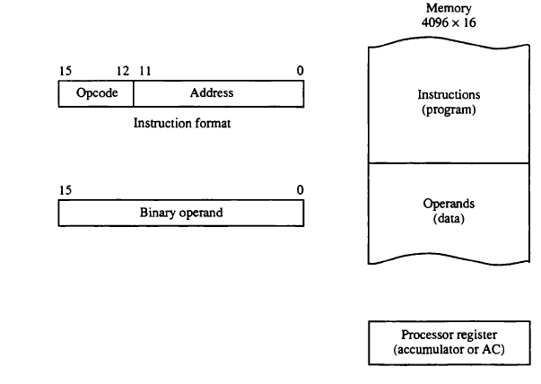
Stored program Organization

Slide 13
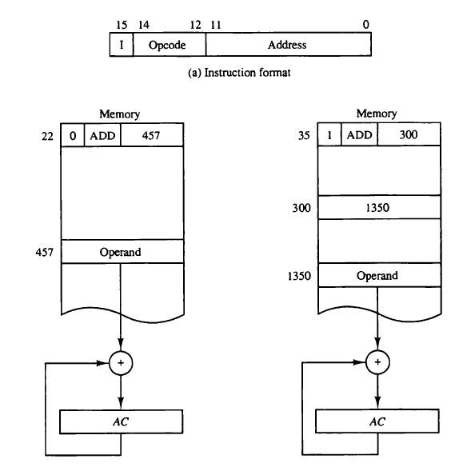

Slide 14
Direct and In Direct Addressing
If the second part of an instruction format specifies the address of an operand, the instruction is said to have a direct address
In indirect address, the bits in the second part of the instruction designate an address of a memory word in which the address of the operand found.

Slide 15
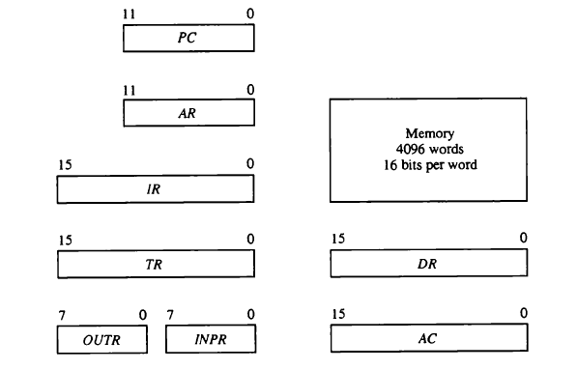
Computer Register
PC (program Counter (12)): holds the address of next instruction
AR(Address Register (12)): holds the address of memory
IR (Instruction Register(16)): holds instruction code.
TR(Temporary Register(16)): holds temporary data generate during certain micro operation. Also it used during the call and return of some subroutines
DR(Data Register(16)): holds the memory operand. Data fetch from memory will be getting stored into this register
AC(Accumulator (16)): processor register. Store the result of any operation.
OUTR(output register): holds output character
INPR Input register: holds input character

Slide 16
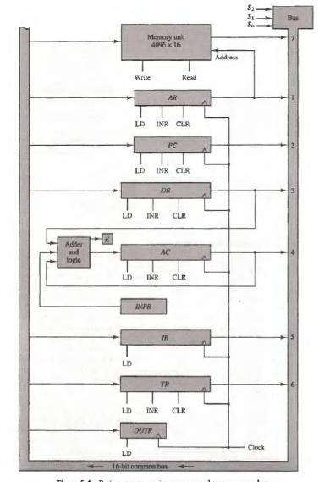
How data transfer from memory to AC?

Slide 17

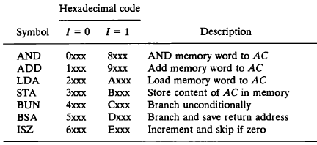
Computer Instruction
Memory Reference Instruction: these instruction are going to deal with memory operands, means the operands provides to this instruction would be fetched from memory.

Slide 18
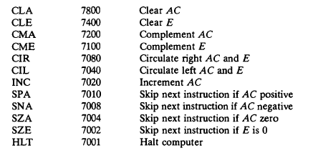

Register Reference Instruction : perform certain instruction on register.

Slide 19
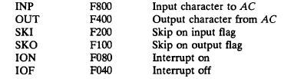
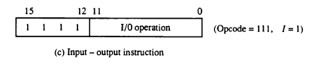
Input-output Instruction

Slide 20
Instruction Set Completeness
Instruction set is said to be complete if it include sufficient number of instruction in each of the following categories:
1. Arithmetic, logic and shift instruction
2. Instruction for moving information to and from memory and processor register
3. Program control instruction together with instruction that check status conditions.
4 Input and output instruction

Slide 21
Timing and control
All Register are controlled by a master clock generator.
Clock plus are applied to all flip flop and register in the system. But this clock plus does not change state of register unless the register is enabled by a control signal.
The control signal are generated in the control unit.

Slide 22
Control organization
Hardwired control : the control logic is implemented with gates, flip flops decoders and other digital circuits.
It can be optimized to produce a fast mode of operation
It require changes in the wiring among the various component if the design has to be modified or changed
Microprogrammed control: the control information is stored in a control memory.
The control memory is programmed to initiate the required sequence of microoperations.
Any required changes or modifications can be done by updating the microprogram in control memory

Slide 23
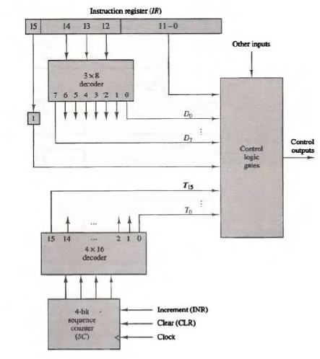
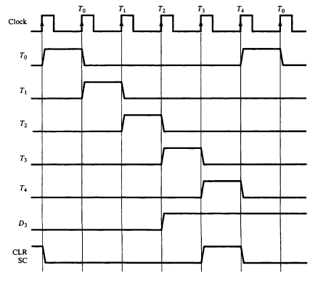
Control unit of basic computer
D3T4: SC<-0

Slide 24
Instruction cycle
A program residing in the memory unit of the computer consists of a sequence of instructions. In the basic computer each instruction cycle consists of the following phases:
Fetch an instruction form memory.
Decode the instruction
Read the effective address from memory if the instruction has an indirect.
Execute the instruction.
After step 4 the control goes back to step 1 to fetch decode and execute the next instruction.
This process continues unless a HALT instruction is encountered

Slide 25

Fetch and decode
PC is loaded with the address of the first instruction in the program.
Sequence counter SC is cleared to zero (0). After each clock plus SC is incremented by one.
The microoperation for fetch and decode phases are as follow:

Slide 26
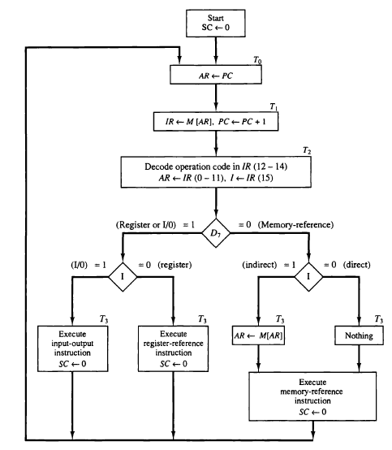
Determine the type of instruction

Slide 27
Questions
A computer uses a memory unit with 256K words of 32 bits each. A binary instruction code is stored in one word of memory. The instruction has four parts: an indirect bit, an operation code, a register code part to specify one of 64 registers, and an address part.
How many bits are there in the operation code, the register code part, and the address part?
Draw the instruction word format and indicate the number of bits in each part.
How many bits are there in the data and address inputs of the memory.
For each of the following 16-bit instructions, give the equivalent four-digit hexadecimal code and explain in your own words what it is that the instruction is going to perform.
a) 0001 0000 0010 0100
b) 1011 0001 0010 0100
c) 0111 0000 0010 0000

Slide 28
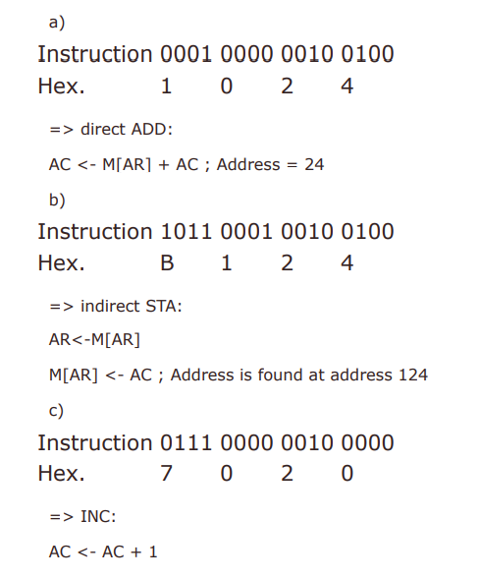

Slide 29
Explanation:
Indirect 1 bit Address 2⁸ (256kB) * 2¹⁰ (1024 bytes/kB) = 2¹⁸ ==> 18 bits
Reg 64 registers = 2⁶ => 6 bits
OP-code 32 – 1 – 18 – 6 bits = 7 bits.

Slide 30
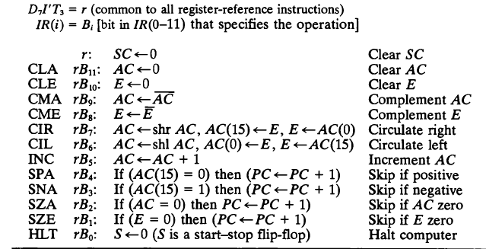
Register reference instruction

Slide 31


Memory reference instruction
1. AND : AND to AC
This is an instruction that perform the AND logic operation on pairs of bits in AC and the memory word specified by the effective address. The result of the operation is transferred to AC
2 .ADD: ADD to AC
This instruction adds the content of the memory word specified by the effective address to the value of AC. The sum is transferred into AC and the output carry Cout is transferred to the E (extended accumulator) flip flop

Slide 32


LDA : Load to AC
This instruction transfer the memory word specified by the effective address to AC
STA: Store AC
This instruction store the content of AC into the memory word specified by the effective address

Slide 33
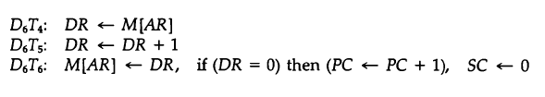

BUN : Branch Unconditionally
This instruction transfer the program to instruction specified by the effective address. The BUN instruction allows the programmer to specify an instruction out of sequence and the program branches unconditionally
ISZ: Increment and skip if zero
These instruction increments the word specified by the effective address, and if the incremented value is o, PC is incremented by 1. since it is not possible to increment a word inside the memory, it is necessary to read the word into DR, increment DR, and store the word back into memory

Slide 34
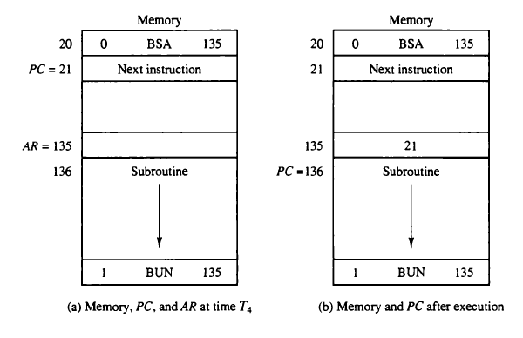


BSA; Branch and save Return Address
This instruction is useful for branching to a portion of the program called a subroutine or procedure. When executed, the BSA instruction stores the address of the next instruction in sequence (which is available in PC) into a memory location specified by the effective address

Slide 35
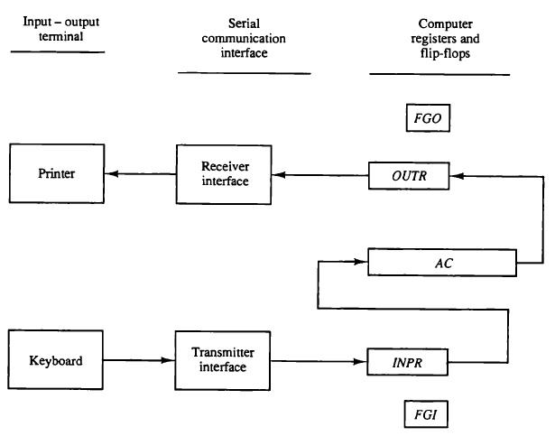
Input-output instruction
FGI is set to 0
Input data is shifted into INPR
FGI is set to 1
Information from INPR is
transferred to AC
Initially FGO is 1
Information from AC to OUTR
FGO is set to 0
Data transfer from OUTR to output device

Slide 36
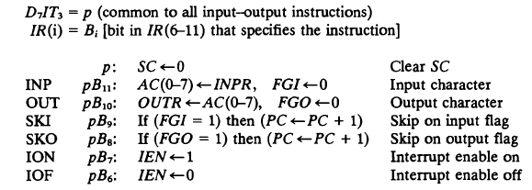
Input-output instruction

Slide 37
Exercise
The content of AC in the basic computer is hexadecimal A937 and the initial value of E is 1. Determine the contents of AC, E, PC, AR and IR in hexadecimal after the execution of the CLA instruction. The initial value of PC is hexadecimal 021.

Slide 38
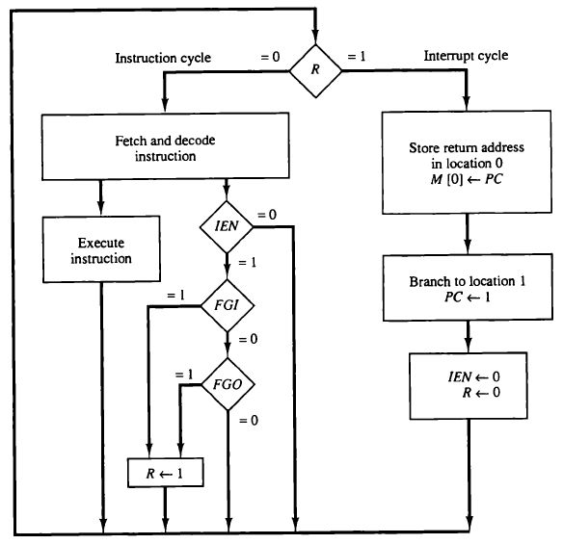


Interrupt cycle
During the normal execution, the program interrupt may occur that means some input or output operation may occur and we are changing our control of execution of our program

Slide 39
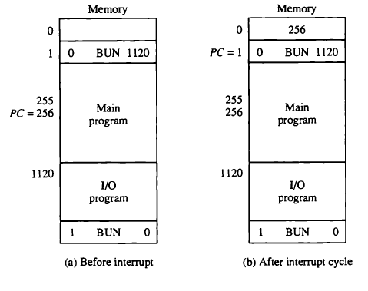

Slide 40
Design of basic computer
A basic computer consists of the following hardware components;
A memory unit with 4096 words of 16 bits each
Nine registers : AR, DR, AC, IR, TR, PC, OUTR, INPR and SC
Seven flip flops: I, S, E, R, IEN, FGI, FGO
Two decoders: a 3X8 operation decoder and 4X16 timing decoder
A 16-bit common bus
Control logic gates
Adder and logic circuit connected to the input of AC

Slide 41
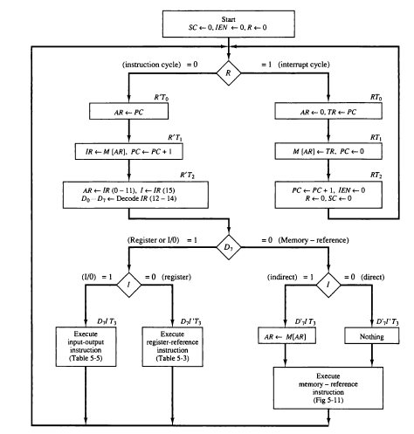
Flow chart for computer operation

Slide 42

Addressing Modes
Dr. Aprna Tripathi
aprnatripathi@gmail.com

Slide 43
Introduction
The mode of access of effective address is called addressing mode.
Effective Address
The address in which the actual operand is available is called as Effective address

Slide 44

Letter for Himself

Slide 45

Letter for one of his family Member

Slide 46


Letter for known house address

Slide 47

Letter for unknown house address

Slide 48
Case1: Letter for him self can be mapped to implicit addressing mode.
Implicit addressing mode
Case2: Letter for one of his family member
2. Immediate addressing mode
Case3: Letter for known house
3. Direct addressing mode
Case4: Letter for unkown house
4. Indirect addressing mode

Slide 49
Implicit Addressing Mode
Operands are specified implicitly in the definition of the instruction
Example:- DEC (Decrement A register)
Opcode
Advantage:
Instruction specifies a fixed and unvarying address
No memory references
Disadvantage:
Limited Computational Capacity

Slide 50
Immediate Addressing Mode
The simplest form of addressing is immediate addressing
data is a part of instruction itself.
Example:- MOVE #100H, R1
Here the data 100h is moved to R1.
MVI A, 01
– MVI stands for Move Immediate. This basically implies move 01 to A.
Opcode
Operand
Advantage:
This mode can be used to define and use constants
or set of initials values of variables.
No memory references
Disadvantage:
Limited Operand size

Slide 51
Direct/Absolute Addressing Mode
Main Memory
The address where data is available is part of the instruction
The address field contains th effective address of the operand.
Example:- MOVE 30A4, R1
The memory location 50A4 is accessed
The data from this location is copied onto Register R1.
Opcode
EA
Operand
Advantage:
Large operand Magnitude
Disadvantage:
Limited Address Size
The change in the location of the program is associated with the change in all absolute memory references.

Slide 52
Indirect Addressing Mode
Main Memory
The Address field refer to the address of a word in memory, which is turn contains a full –length address of the operand.
The address field contains the address of effective address of the operand.
Example:- MOVE (30A4), R1
The memory location 50A4 is accessed for the EA
The data from EA location is copied onto Register R1.
Opcode
(EA)
Advantage:
Large address space
EA
Disadvantage:
The change in the location of the program is associated with the change in all absolute memory references
Operand

Slide 53
Register Direct Addressing Mode
The only difference is that the address field refers to a register rather than a main memory address
Register addressing is similar to direct addressing
Example:- MOVE R2, R1
The content of register R2 is copied into register R1
Registers
Opcode
R
Operand
Advantage:
No memory Reference
Disadvantage:
Limited number of registers

Slide 54
Register Indirect Addressing Mode
Main Memory
Register indirect is just analogous to indirect addressing in the both cases; the only difference is whether the address field refers to memory location or a register.
Example:- MOVE (R2), R1
The content of address availble in register
is copied into Register R1
Operand
Registers
Opcode
(R)
Advantage:
Large address space
EA
Disadvantage:
Extra memory space

Slide 55
Summary
Addressing Modes
Implied/Implicit Addressing mode
Immediate Addressing mode
Direct Addressing mode
Indirect Addressing mode
Register Direct Addressing mode
Register Indirect Addressing mode

Slide 56
Assignmet
Collect a instruction set of any processor and categorize them based on Addressing modes.

Slide 57
References
Text Book
William Stallings “Computer Organization and architecture” Prentice Hall, 7th edition, 2006

